Slide 1
Modeling Pooled-Testing for covid-19 with correlated samples
Saskia Comess
Collaboration with Claire Donnat
Holmes Group Meeting, 4 December

Slide 2
overview
BACKGROUND
Mass testing is needed to control the COVID-19 outbreak, but testing resources limited
Pooled testing: advantages and challenges
STANFORD POOLED TESTING PERFORMANCE STUDY
Characterized effect of dilution on analytical sensitivity through sample pooling using empiric data and modeling
Assume all samples are independent and identically distributed
CORRELATION STRUCTURES
How does test sensitivity change when iid assumptions are violated?
Two models for introducing correlations
Correlation in C_{t} values
Correlation at transmission level (network model)
Notes:
Key principles for successful application of group testing involve knowledge of the limit-of-detection, sensitivity, and specificity of the assay, and the prevalence of disease in the population. The goal of the process is to determine a pool size that provides the greatest conservation of resources while maintaining the reliable performance of testing.

Slide 3
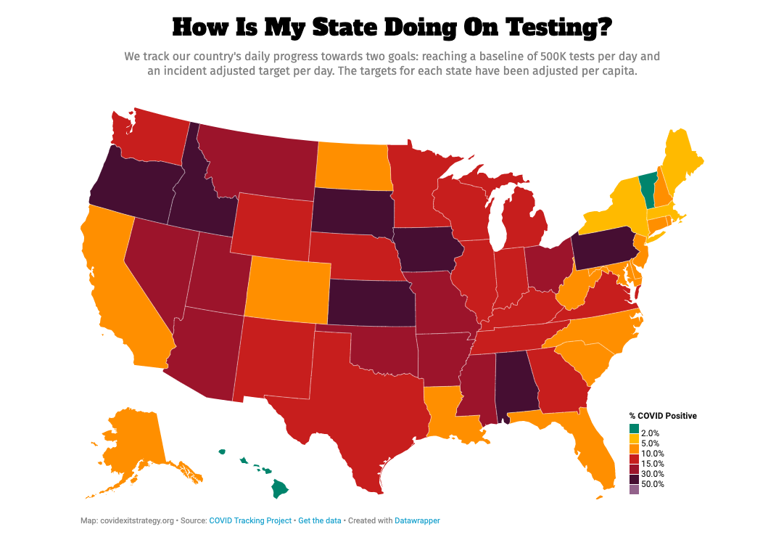
Notes:
https://www.covidexitstrategy.org/

Slide 4
Nonpartisan report warns of COVID-19 testing shortages in over half US states, territories [ABC News, nov. 2020]
A Rush On Coronavirus Testing Strains Laboratories, Drives Supply Shortages
[NPR, Nov. 2020]
FDA issues first emergency use authorization for Covid-19 pool testing
[CNN, July, 2020]
The mathematical strategy that could transform coronavirus testing [Nature, July 2020]
Stanford Health Care can begin pooled testing for COVID-19 [Stanford News, July 2020]
Notes:
https://www.cnn.com/2020/07/18/health/pool-testing-fda-authorization/index.html
https://www.bostonglobe.com/2020/11/17/opinion/pooled-covid-19-testing-can-help-keep-kids-school/
https://www.nature.com/articles/d41586-020-02053-6
https://med.stanford.edu/news/all-news/2020/07/stanford-health-care-can-begin-pooled-testing-for-covid-19.html

Slide 5
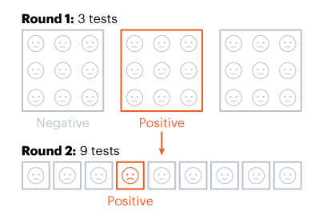
Background
Pooled testing: combining samples from several people and conducting one laboratory test on the combined pool of samples
Dorfman 2-stage pooling →
Notes:
If a pooled sample is negative, all individuals in the pooled sample are deemed negative. If the pooled sample is positive, the individual samples from the pool are then tested.
https://www.cdc.gov/coronavirus/2019-ncov/lab/pooling-procedures.html
https://idss.mit.edu/wp-content/uploads/2020/04/04.28.2020pooled_testing.pdf
https://www.nature.com/articles/d41586-020-02053-6

Slide 6
considerations
Advantages: potentially allows labs to test more samples using fewer materials; reduce number of tests needed to screen more individuals
Caveats / Limitations:
DISEASE PREVALENCE
DILUTION & ANALYTIC SENSITIVITY
POOLING STRATEGY, OPTIMAL POOL SIZE
Notes:
Key principles for successful application of group testing involve knowledge of the limit-of-detection, sensitivity, and specificity of the assay, and the prevalence of disease in the population. The goal of the process is to determine a pool size that provides the greatest conservation of resources while maintaining the reliable performance of testing.
TRADEOFF: larger pools save more resources, but they also dilute samples more and make it harder to detect presence of virus
Nebraska public health study: https://academic.oup.com/ajcp/article/153/6/715/5822023

Slide 7
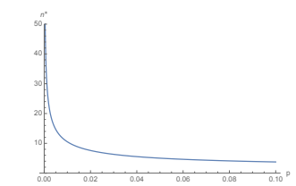
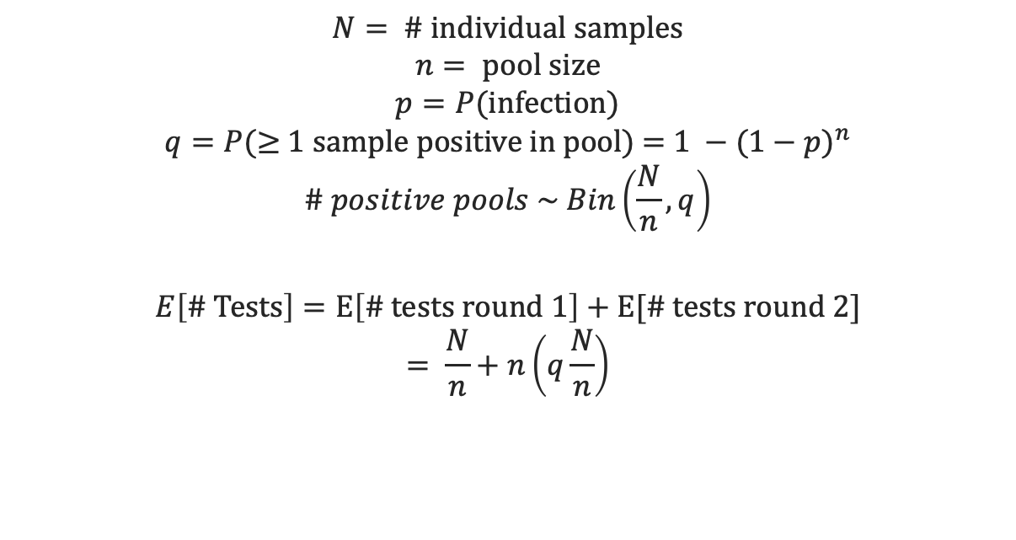
Efficiency: Homogenous population, independent samples
$$N= \text{\# }\text{individual} \text{samples}$$
$$n= \text{pool} \text{size}$$
$$p=P(\text{infection}\text{)}$$
$$q=P(\text{≥}\text{ 1 }\text{sample} \text{positive} \text{in} \text{pool}\text{) = }1 −{(1−p)}^{n}$$
$$\# positive pools \sim Bin\left(\frac{N}{n}, q\right)$$
$$E\left[\text{\# }\text{Tests}\right]=E\left[\# tests round 1\right]+E[\# tests round 2]$$
$$= \frac{N}{n}+n\left(q\frac{N}{n}\right)$$
Optimal pool size for Dorfman testing as a function of prevalence
Notes:
Traditionally, the samples mixed in a group are assumed to be independent and identically distributed Bernoulli random variables.
Decomposing this expectation, we have N/n pools to test in the first round and then n times the number of positive pools to test in the second round. The number of positive pools from the first round is a random variable and is distributed Binomial(N/n, q) with expectation q(N/n)
https://idss.mit.edu/wp-content/uploads/2020/04/04.28.2020pooled_testing.pdf
** assuming perfect sensitivty

Slide 8
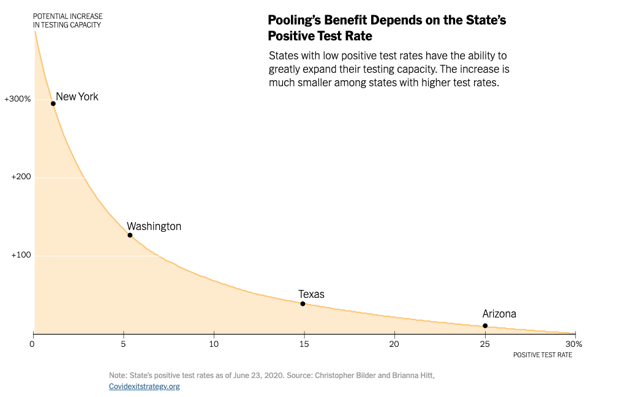
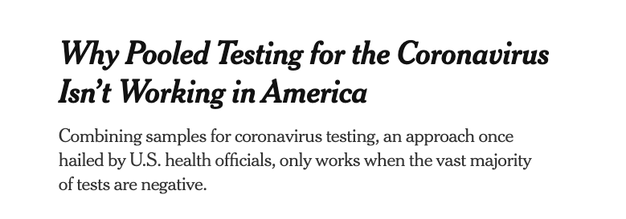
prevalence
PREVALENCE: Efficiency of pooled testing strategy decreases as prevalence increases
Lower prevalence → larger optimal pool size, less retesting needed
Most efficient when prevalence is at least less than 5% (possibly < 1%?)
Nebraska Public Health Study: one positive sample + four negatives reduced number of tests by >50 when COVID-19 prevalence < 5%
Notes:
Nebraska public health study: https://academic.oup.com/ajcp/article/153/6/715/5822023
NYTimes: https://www.nytimes.com/2020/08/18/health/coronavirus-pool-testing.html
https://www.nytimes.com/interactive/2020/07/27/upshot/coronavirus-pooled-testing.html?action=click&module=RelatedLinks&pgtype=Article

Slide 9
DILUTION & ANALYTIC SENSITIVITY
Sensitivity = proportion of people who have disease that are correctly identified as positive
Combining specimens → dilution → lower concentration of viral genetic material, possibly below the limit of detection of test
Larger pools → higher probability of false-negatives
C_{t} Value = Cycle Threshold Value
Number of PCR cycles needed to detect the virus
No detection after 37 to 40 cycles = negative test
Indicates how much virus an infected person has
Notes:
A test that registers a positive result after 12 rounds, for a CT value of 12, starts out with more than 10 million times as much viral genetic material as a sample with a CT value of 35)
low Ct values indicated the presence of higher amounts of viral RNA and high Ct values indicated lower amounts.
Pooling samples INCREASES the Ct

Slide 10
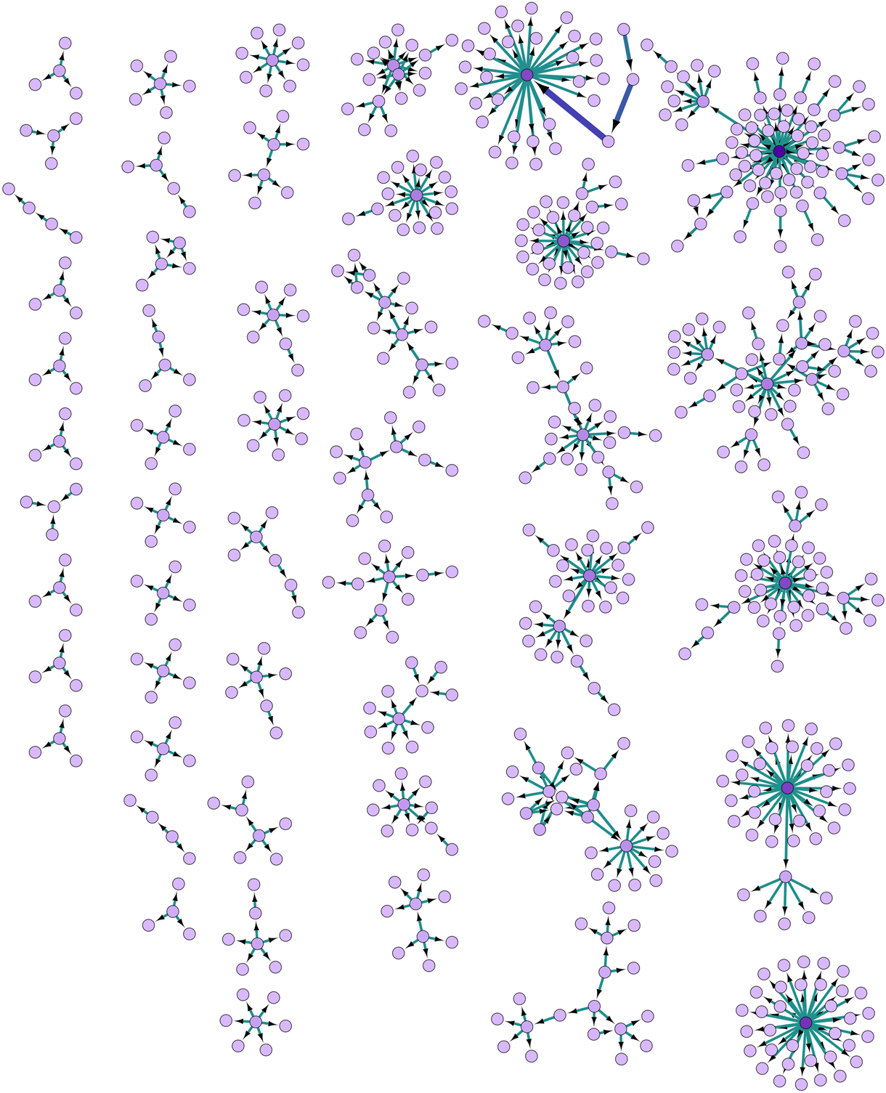
Pooling strategy
“Routine” approach: first sample pools are assembled randomly in the laboratory for analysis
Assumes samples are independent! (# positives in a group has binomial distribution)
Valid for COVID-19?
Relations between individuals (families, office colleagues or neighbors, passengers on airplane) determine risk of infection
Could form homogeneous pools of correlated individuals
Notes:
Figure from https://www.cambridge.org/core/journals/epidemiology-and-infection/article/social-network-analysis-of-covid19-transmission-in-karnataka-india/EDFB0A9733D163B3ED7D4271B3C50C13
Decekert et al. 2020- Comparing routine to context-sensitive pooling approaches: https://www.ncbi.nlm.nih.gov/pmc/articles/PMC7463190/pdf/BLT.20.257188.pdf
Simple Dorfman procedure assumes samples are IID - but in reality they are not identically distributed (risk factors) and not independent (correlated)
these considerations are somewhat novel to coronavirus, because group testing not previously used on such a wide scale

Slide 11
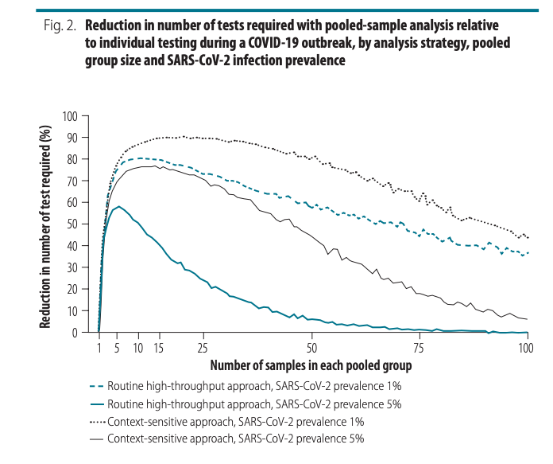
Pooling strategy
Deckert et al. (2020) simulated routine and “context-sensitive” pooling approaches
Parameters:
Population size: 150 000 or 15 000
Prevalence: 0.5 to 20%, in incremental steps of 0.5%
Group size: 2 to 100
Routine: # infected individuals in each group distributed binomial(overall prevalence, group size)
Context-sensitive:
Within group infection prevalence decreases (non-linearly) with increasing group size as group becomes more heterogeneous
# infected individuals in each group distributed binomial(within-group prevalence, group size).
Notes:
Routine: with a prevalence of 1%, selecting a group size between 5 and 50 implies at least 58% fewer tests. With a high prevalence of 10%, a reduction in the number of tests of around 40% can still be achieved but the selected group size must be close to 3. When the prevalence is high and the group size is large, the number of tests required slightly exceeds the number required for individual testing
Context-sensitive: with a prevalence of 1%, selecting a group size between 5 and 50 implies at least 76% fewer tests. With a high prevalence of 10%, a reduction of around 65% is still achievable, though the selected group size must be close to 10 (data repository)
https://www.ncbi.nlm.nih.gov/pmc/articles/PMC7463190/pdf/BLT.20.257188.pdf

Slide 12
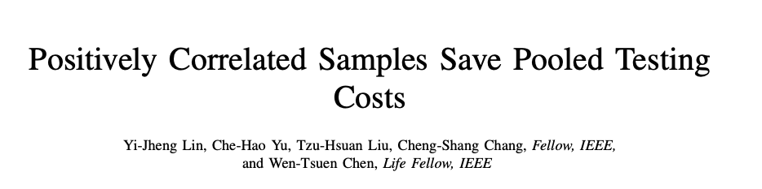
Deckert et al. (2020) showed by simulation that pooled samples from homogeneous groups of similar people lead to cost reduction for the Dorfman two-stage method
Lin et al. (2020) provide mathematical proof for this finding
Model the arrival process to a COVID-19 testing site: show that the expected relative cost for positively correlated samples is not higher than that of i.i.d. samples with the same prevalence rate
Do not account for other factors – e.g. dilution, analytic sensitivity
Notes:
expected relative cost = the ratio of the expected number of tests required by the group testing method to the number of tests required by the individual testing
Article available pre-print, Nov 2020 https://arxiv.org/pdf/2011.09794.pdf

Slide 13
overview
BACKGROUND
Mass testing is needed control the COVID-19 outbreak, but testing resources limited
Pooled testing: advantages and challenges
STANFORD POOLED TESTING PERFORMANCE STUDY
Characterized effect of dilution on analytical sensitivity through sample pooling using empiric data and modeling
Assume all samples are IID
CORRELATION STRUCTURES
How does test sensitivity change when independent and identically distributed assumptions are violated?
Two models for introducing correlations
Correlation in Ct values
Correlation at transmission level (network model)

Slide 14
“SARS-CoV-2 Pooled Test Performance” (Pinsky Lab, Stanford)
LAB METHODS:
Tested 1,648 prospectively-pooled specimens
C_{t} result between 40-45 = indeterminate result; > 45 = negative
STATISTICAL METHODS:
Developed simulation model to estimate the effects of dilution on positive percent agreement (PPA) and efficiency of a two-stage pooled testing algorithm
Validated model using the empiric lab data
Assumed independence between samples in same pool
OBJECTIVE:
Develop empirically validated model to predict optimal pool size and associated expected PPA based on limit of detection, C_{t} value distribution, and proportion of positive tests.
Definition {PPA}: Proportion of comparative/reference method positive results in which the test method result is positive. Sensitivity requires knowing the true status of the subject.
Notes:
In a pool with x people positive out of X total, this is the expected sensitivity (PPA).
Type of tests used: using three different NAATs for SARS-CoV-2: a laboratory-developed real-time reverse transcription PCR (rRT-PCR) assay targeting the E gene, and two commercially-available Panther System assays targeting ORF1ab
PPA: PPA is an agreement statistic for diagnostic tests. To calculate sensitivity, the true state of the subject, whether the subject does have the illness or condition, must be known.
https://analyse-it.com/blog/2020/4/diagnostic-accuracy-sensitivity-specificity-versus-agreement-ppa-npa-statistics

Slide 15
Modeling PPA (adapted from pinsky et al.)
(1) Fit C_{t} values of positive samples to candidate continuous probability distributions, select best-fitting distribution: slight negative skewness → Weibull distribution (shape = 4.55, scale parameters = 29.86)
(2) Generate set of random C_{t} values: sample 50,000 times from this distribution (base case); shift C_{t} values to have 5-30% of values above LoD (to test differing viral loads)
Notes:
Best fitting distribution selected based on the Bayesian information criterion and Kolmogorov-Smirnov statistic (0.0436).

Slide 16
Modeling ppa (adapted from pinsky et al.)
(3) Apply model
Input parameters: PPA depends on
1) Proportion of positive tests: 0.1%, 1.0%, 3.0%, 5.0%, 10.0%, 15.0%
2) Assay analytical sensitivity:
95% assay limit of detection (LoD) C_{t} = 35
C_{t} value corresponding to the probability of detecting 95% of true positives (95% LoD). Specimens with C_{t} > LoD are assigned a decreasing probability of detection based on a probit regression curve (derived from empiric data)
3) Viral load distribution:
% of individual amplified C_{t} values above the LoD- 5%, 10%, 15%, 20%, 25%, 30%
4) Pool size: 1-20
Notes:
at each Ct value you have a probability of detection; above LoD (35) definitely negative, below the LoD its stochastic and there is a probability of being positive
lower Ct means easier detection
increasing proportion of positive tests is like increasing prevalence in the general population

Slide 17
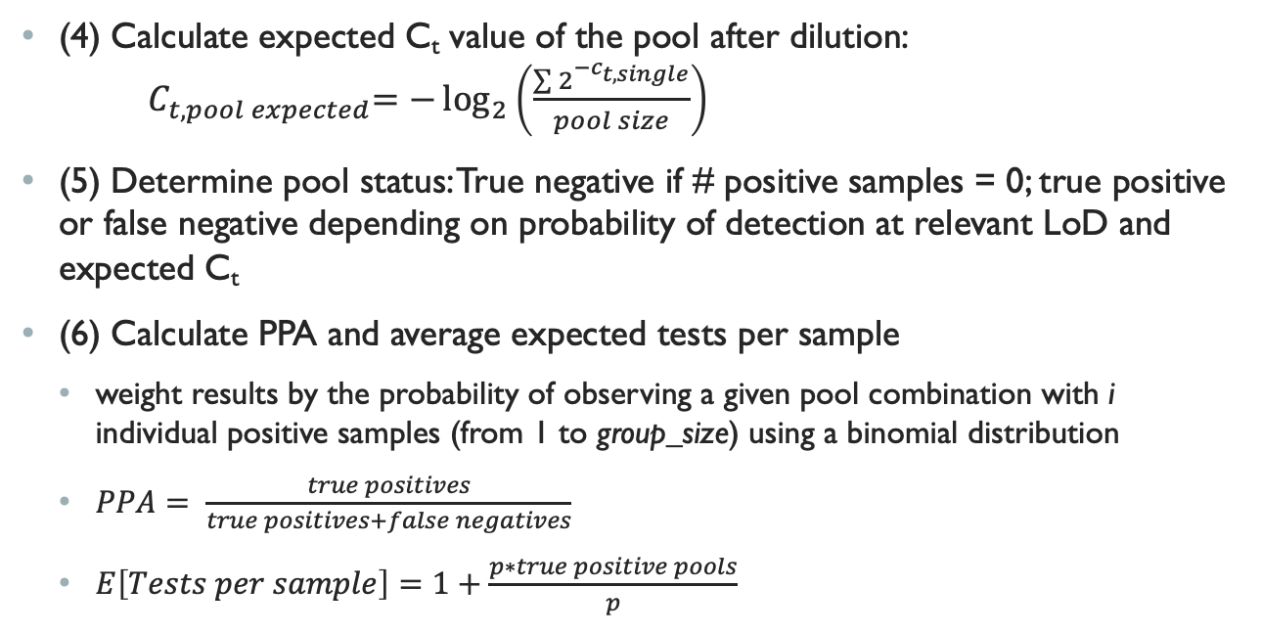
Modeling PPA (adapted from pinsky et al.)
(4) Calculate expected C_{t} value of the pool after dilution: ${ C}_{t, pool expected}=−\log_{2}\left(\frac{\sum{2^{{−c}_{t, single}}}}{pool size}\right)$
(5) Determine pool status: True negative if # positive samples = 0; true positive or false negative depending on probability of detection at relevant LoD and expected C_{t}
(6) Calculate PPA and average expected tests per sample
weight results by the probability of observing a given pool combination with i individual positive samples (from 1 to group_size) using a binomial distribution
$PPA= \frac{true positives}{true positives+false negatives}$
$E\left[Tests per sample\right]=1+\frac{p∗true positive pools}{p}$

Slide 18
overview
BACKGROUND
Mass testing is needed control the COVID-19 outbreak, but testing resources limited
Pooled testing: advantages and challenges
STANFORD POOLED TESTING PERFORMANCE STUDY
Characterized effect of dilution on analytical sensitivity through sample pooling using empiric data and modeling
Assume all samples are IID
CORRELATION STRUCTURES
How does test sensitivity change when independent and identically distributed assumptions are violated?
Two models for introducing correlations
Correlation in Ct values
Correlation at transmission level (network model)

Slide 19
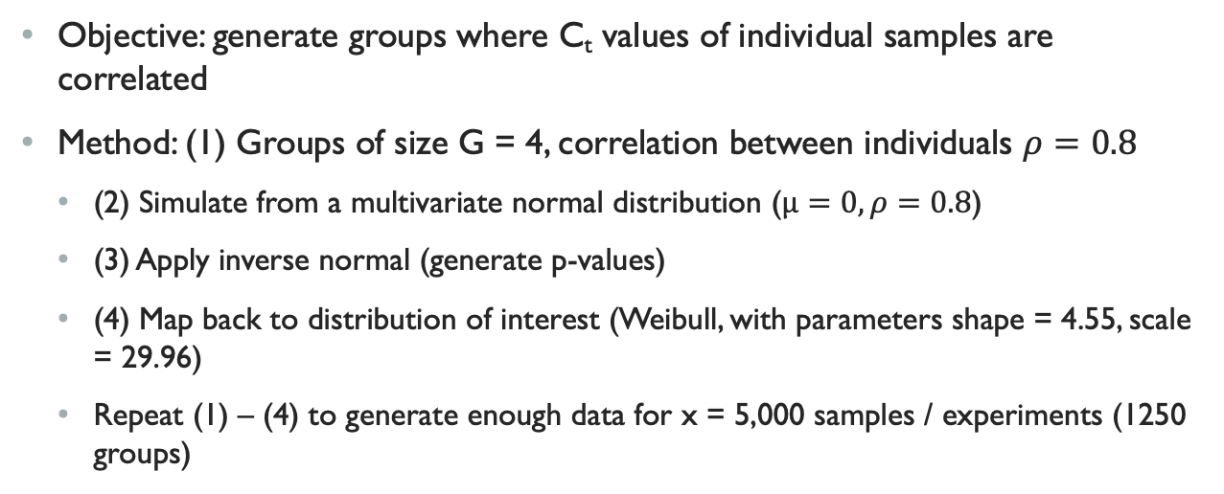
Correlation in ct values
Objective: generate groups where C_{t} values of individual samples are correlated
Method: (1) Groups of size G = 4, correlation between individuals $ρ=0.8$
(2) Simulate from a multivariate normal distribution ($μ=0, ρ=0.8$)
(3) Apply inverse normal (generate p-values)
(4) Map back to distribution of interest (Weibull, with parameters shape = 4.55, scale = 29.96)
Repeat (1) – (4) to generate enough data for x = 5,000 samples / experiments (1250 groups)

Slide 20
Experiments with correlated samples
Vary proportion of tests positive, pool size and percent of samples with Ct > LoD, then compare average tests per sample and positive percent agreement
Vary correlation structure and sampling :
Sample correlated data uniformly (destroy correlation structure)
Sample by correlated data groups
Vary fraction of group sampled (fraction = 1, ¾, ½)
Populate pools correlated data sampled by group (up to group size G), fill remaining spaces in pool with individuals sampled uniformly at random

Slide 21
Correlated Data sampled Uniformly vs Uncorrelated Data
Expected PPA as function of pool size, proportion Ct > LoD, proportion of tests positive
Results:
- Increasing proportion Ct >LoD → decreases PPA
- Decreasing prop. positive → decreases PPA
- Increasing pool size → decreases PPA at low prevalence, increases PPA at high prevalence
- No difference between correlated data sampled uniformly and uncorrelated data
Notes:
Vary proportion of population w/ Ct > LoD, proportion of tests positive, and pool size
(assay analytic sensitivity (LoD) = constant at experimentall-derived value of 35)
FIGURE A
COMPARING ACROSS PANELS (increasing proportion of samples with Ct values > 95% LoD)
Increasing Ct means LESS viral load in a sample, so we expect that increasing Ct will make a test less sensitive (able to detect positive cases)
UNCORRELATED DATA (dashed line): Increasing proportion of tested population with C_{t} value >95% LoD -> PPA decreases
CORRELATED DATA (solid line): Increasing proportion of tested population with C_{t} value >95% LoD -> PPA decreases
Comparing uncorrelated and correlated: don’t have a consistent trend??
COMPARING line color (WITHIN A GIVEN PANEL)
At a given sensitivity and proportion of samples with Ct>LoD, greater proportion of tests positive increases PPA
Effect of pool size: As prevalence increases, PPA can counterintuitively increase with larger pool sizes as there is a greater likelihood of having more than one positive sample in a given pool, which would be expected to increase PPA. At >5% test positivity, expected PPA starts to increase at larger pool sizes as there is a greater likelihood of two positive samples being in the same pool. The baseline PPA (pool size of one) reflects the likelihood of obtaining the same individual result with repeat (non-pooled) testing

Slide 22
Correlated Data sampled Uniformly vs Uncorrelated Data
Testing efficiency as function of pool size, proportion Ct>LoD, proportion of tests positive
Results:
- Decreasing prop. Positive (prevalence) → increasing efficiency
- No difference between correlated data sampled uniformly and uncorrelated data
Notes:
Vary proportion of population w/ Ct > LoD, proportion of tests positive, and pool size
(assay analytic sensitivity = constant)
Expected tests per sample using a 2-stage pooled testing design (if a group tests positive, every individual is re-tested)
Lower number of average tests per sample corresponds to higher testing efficiency
Average expected tests per sample is almost entirely determined by pool size and prevalence
. Efficiency increases with decreasing proportion of tests positive
Efficiency slightly increases with increasing samples with C_{t} above the LoD

Slide 23
Correlated Data sampled by group vs Uncorrelated Data
Correlated vs. uncorrelated: large pool size, many samples above LoD → lower PPA than uncorrelated
Expected PPA
Overall trends:
- Increasing Ct → decreases PPA
- Decreasing prop. positive → decreases PPA
- Increasing pool size → decreases PPA at low prevalence, increases PPA at high prevalence
Notes:
Vary proportion of population w/ Ct > LoD, proportion of tests positive, and pool size
(assay analytic sensitivity = constant)
Expected tests per sample using a 2-stage pooled testing design (if a group tests positive, every individual is re-tested)
Lower number of average tests per sample corresponds to higher testing efficiency
Average expected tests per sample is almost entirely determined by pool size and prevalence
. Efficiency increases with decreasing proportion of tests positive
Efficiency slightly increases with increasing samples with C_{t} above the LoD
correlation structure means that if first person sampled is above LoD, then next person sampled is very likely to be above LoD - bad samples very bad (whereas with independence, it is random whether next person is above / below LoD)

Slide 24
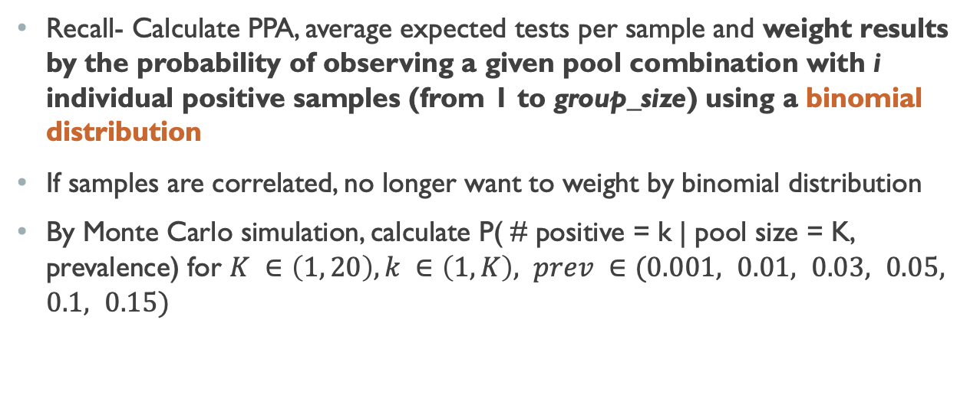
Simulating Correlation in transmission
Recall- Calculate PPA, average expected tests per sample and weight results by the probability of observing a given pool combination with i individual positive samples (from 1 to group_size) using a binomial distribution
If samples are correlated, no longer want to weight by binomial distribution
By Monte Carlo simulation, calculate P( # positive = k | pool size = K, prevalence) for $K ∈\left(1, 20\right), k ∈\left(1, K\right), prev ∈(0.001, 0.01, 0.03, 0.05, 0.1, 0.15)$

Slide 25
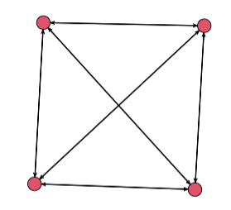
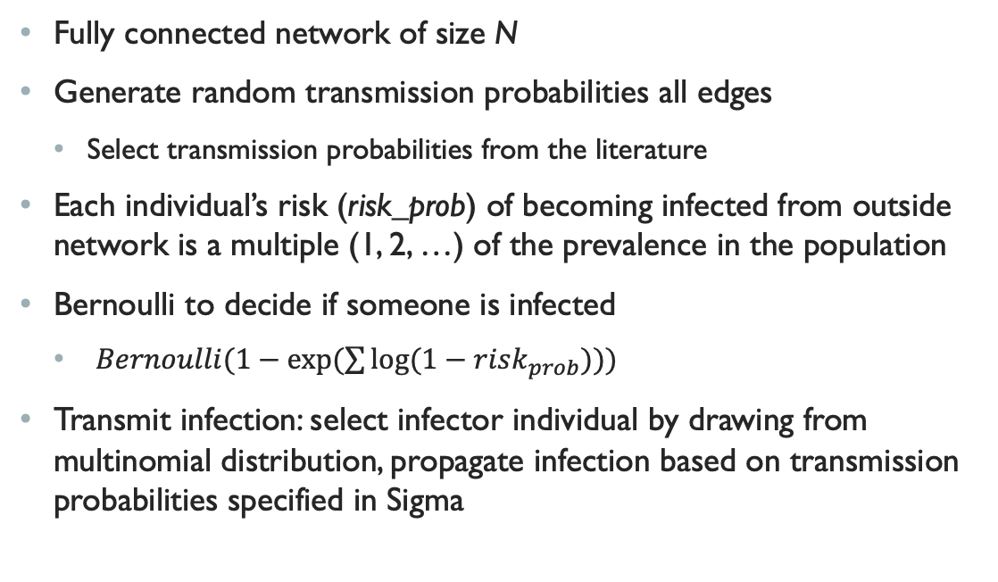
Simulating Correlation in transmission
Fully connected network of size N
Generate random transmission probabilities all edges
Select transmission probabilities from the literature
Each individual’s risk (risk_prob) of becoming infected from outside network is a multiple (1, 2, …) of the prevalence in the population
Bernoulli to decide if someone is infected
$Bernoulli(1−exp⁡(\sum{log⁡(1−risk_{prob})))}$
Transmit infection: select infector individual by drawing from multinomial distribution, propagate infection based on transmission probabilities specified in Sigma
Notes:
$N^{2 }$uniformly distributed values from .1 to 0.9
Convert to symmetric matrix: Sigma = 0.5 * (Sigma + t(Sigma))
1- probability that no one is infected

Slide 26
Next steps
Recalculate PPA and average expected tests per sample using P( # positive = k | pool size = K, prevalence) determined via simulation for correlated data
Use probabilities of transmission within different groups from the literature
Adapt models to reflect networks of differing risks
Develop recommendations for testing based on groups of differing risks

Slide 27
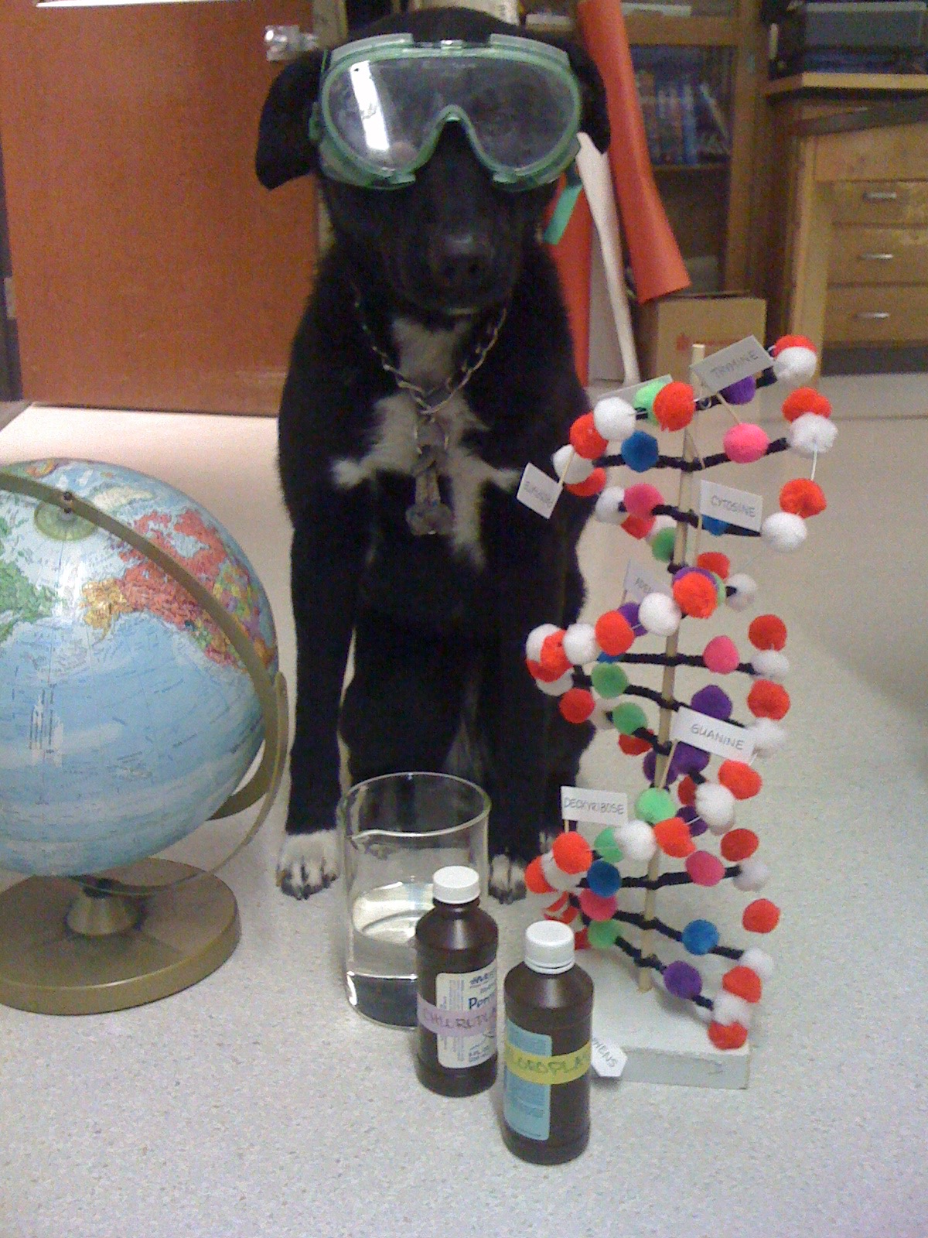
acknowledgements
Pinsky Lab: Hannah Wang, MD; Catherine A. Hogan, MD, MSc; Benjamin A. Pinsky, MD, PhD
Holmes Group: Claire Donnat, Susan Holmes

Slide 28
Tests per sample, correlated data

Slide 29
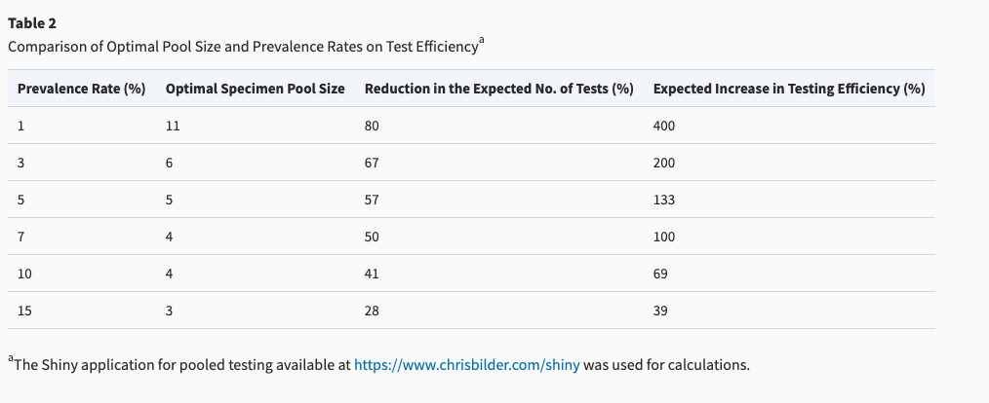
Tradeoff between prevalence and pool size
Notes:
https://academic.oup.com/ajcp/article/153/6/715/5822023

